Slide 1
An Introduction to Agent Based Modeling (ABM)

Slide 2
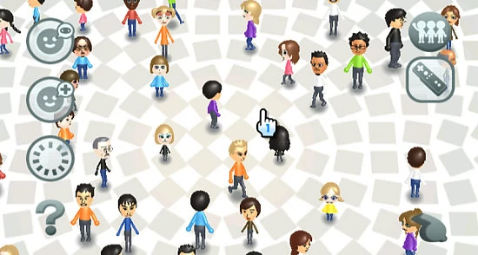
What is Agent Based Modeling??
ABM is a methodology that is used to build formal models of real-world systems
Where these systems are made up by individual units
Atoms, cells, animals, humans, institutions...etc.
These individual units repeatedly interact among themselves and/or their environment

Slide 3
The Essence of ABM
So what makes Agent Based Modeling Different from other Formal Model Methodologies?
The defining feature of the ABM ‘approach’ is that it establishes direct and explicit correspondence…
Between the individual units in the target system to be modeled, and the parts of the model that represent these units (i.e.) the agents
Between the interactions of individual units in the target system and the interactions of corresponding agents in the model

Slide 4
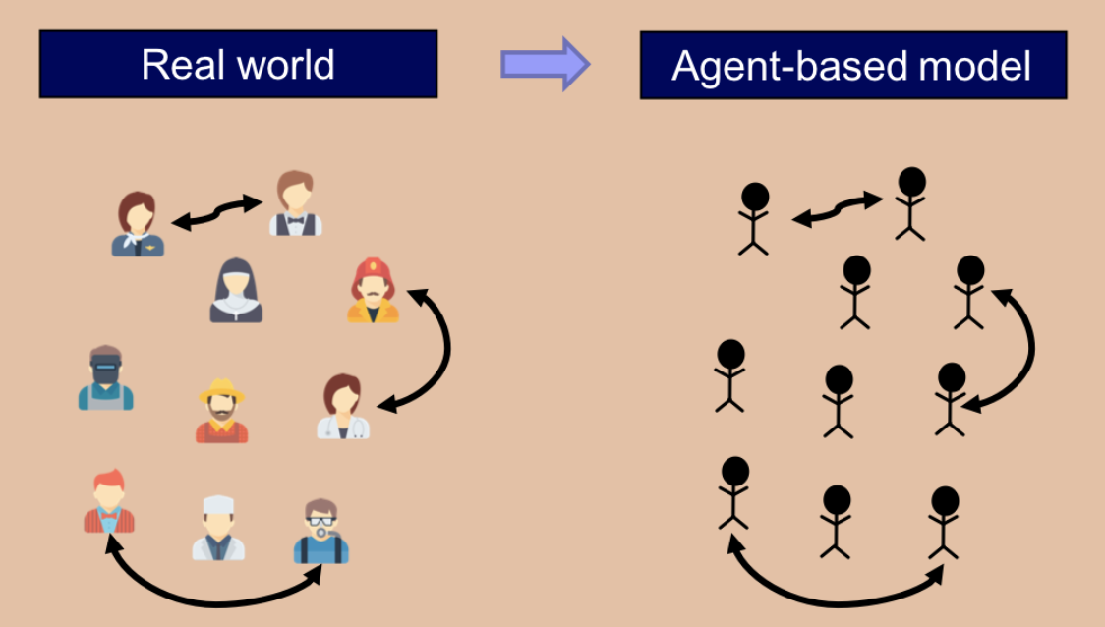
Understanding what I just said with a picture

Slide 5
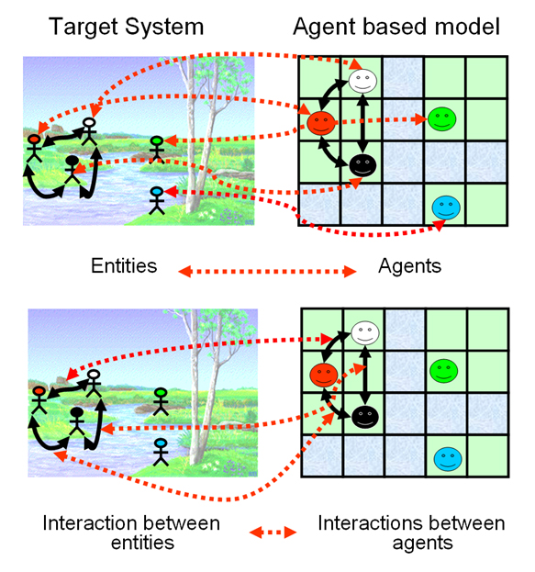
Thus...
In ABM, the individuals units of the system and their repeated interactions are explicitly and individually represented in the model.
Beyond this...no further assumptions!

Slide 6
Benefits of ABM
Flexibility - in principle, you can make your agent-based model as complex as you wish.
Captures Emergent Phenomena - emergent phenomena result from the interactions of individual entities.
Provides a natural description of a system

Slide 7
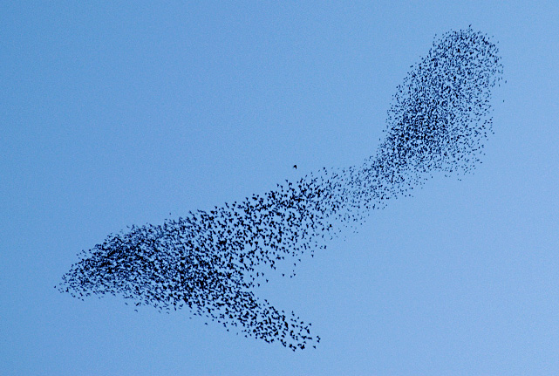
Emergent Phenomena
Emergent Phenomenon result from the interactions between individuals beings.
By definition, they are greater than the sum of their parts
Emergent phenomenon can have properties that are decoupled from the properties of the parts.
ABM by its nature, is the canonical approach to modeling emergent phenomena.

Slide 8
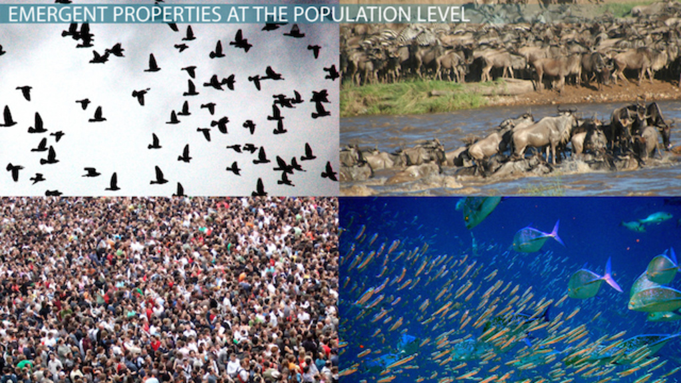
When to use ABM for Emergent Phenomena
Individual Behavior is nonlinear and can be characterized by
If-then rules
Nonlinear coupling
Individual behavior exhibits memory, path-dependence, non-markovian behavior

Slide 9

What is an agent?
Agents can be thought of as decision-makers in our model.
Human, non-human, animals, institutions, firms, etc.
Agents have individually-owned variables, which describe their internal state (e.g. a strategy)
They are able to conduct certain computations or tasks
Instructions are sometimes called decision rules, or rules of behavior
Most often imply some kind of interaction with the other agents or with the environment

Slide 10
Examples of individually-owned variables and instructions, respectively
Examples of individually-owned variables
Strategy (a number)
Payoff (a number)
My-coagents (set of agents with whom this agent interacts with)
Color (color of this agent)
Examples of instructions
To play (play a certain game with my-coplagents and set the payoff appropriately)
To update-strategy (revise strategy according to a certain revision rule)
To update-color (set color according to strategy)

Slide 11
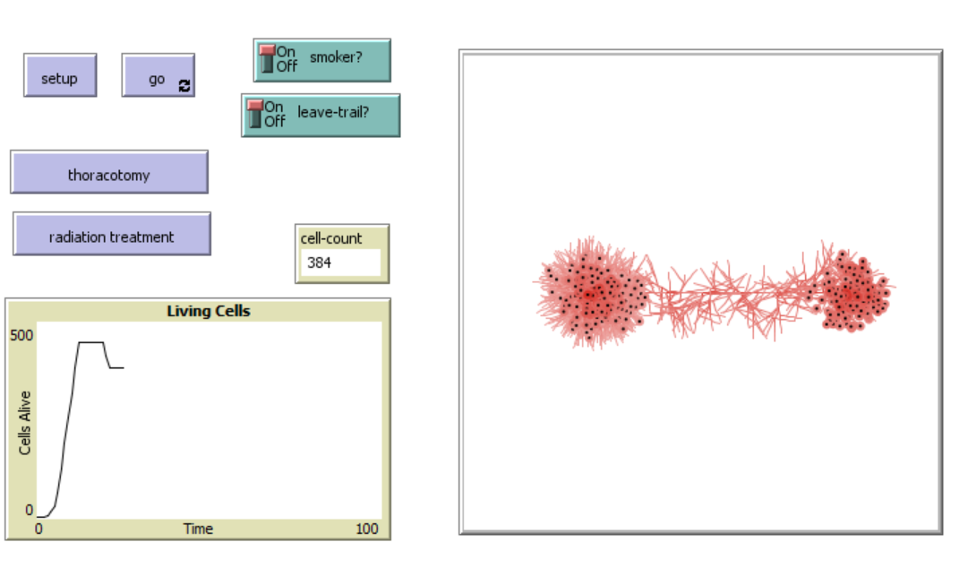
In Today’s Workshop: Tumor Model

Slide 12
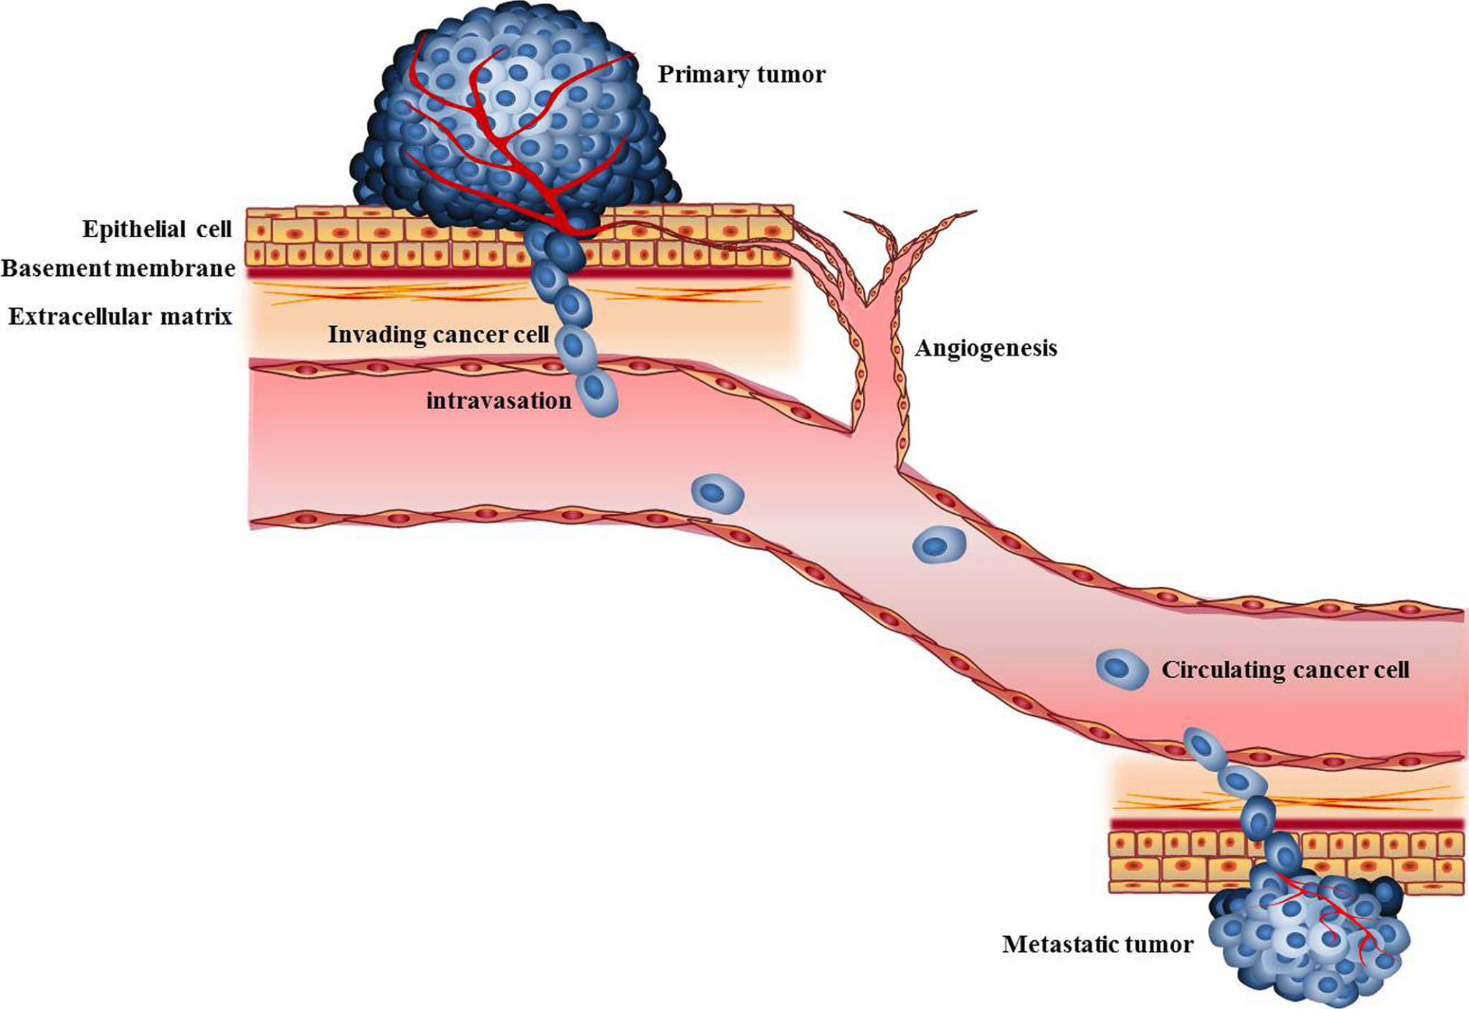
Stem Cells and Tumors
Stem cells are cells with the potential to develop into many different types of cells in the body.
Through accumulation of mutations over time, uncontrolled cell divisions in the stem cells can cause cancer.

Slide 13
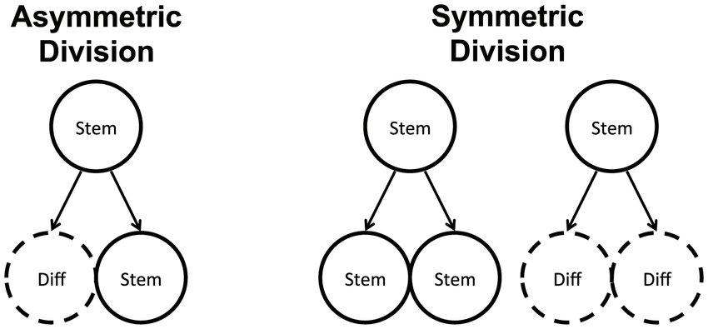
Types of Stem Cell Divisions

Slide 14
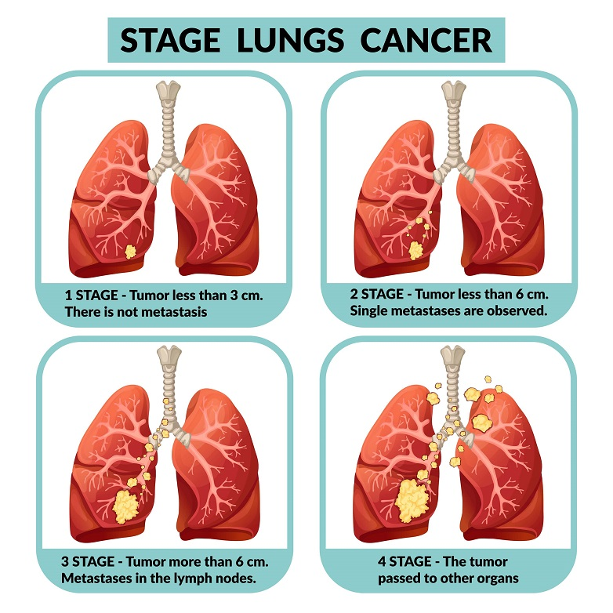
Smoking and Lung Cancer
Tobacco smoke contains at least 60 carcinogen chemicals.
These chemicals cause mutations in cells that drive cancer genes to become active and lead to tumorigenesis.

Slide 15
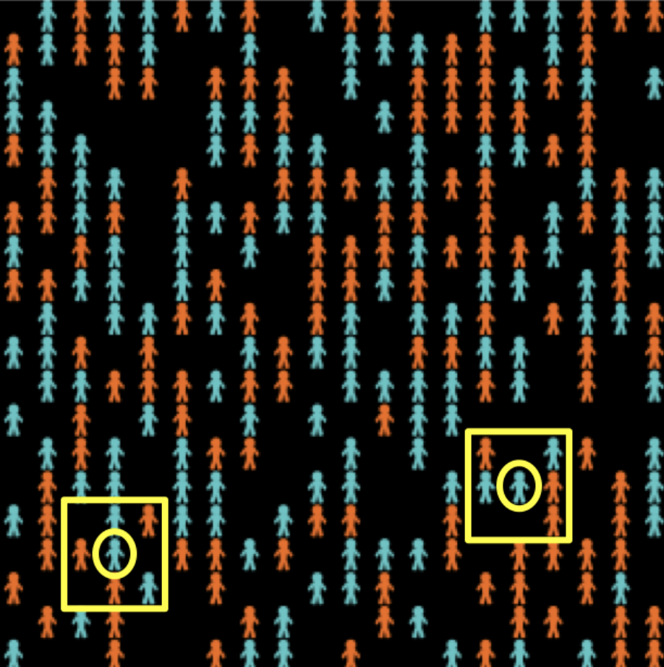
Bonus: A Canonical ABM Example
133 blue agents, 133 orange agents who live in a 2-dimension grid made up of 20x20 cells
Agents initialize at a random location
The ‘neighborhood’ of a cell is defined by the eight neighboring cells
Agents may be happy or unhappy.
Happy if the proportion of other agents of its same color in its neighbourhood is greater than or equal to a certain threshold
Otherwise, unhappy

Slide 16
A Canonical Example Continued
Every iteration, one unhappy agent is randomly selected to move to a random empty cell in the lattice
For example, let’s take a look at the two agents on circled on the left here

Slide 17
IO Variables and Instructions of Agents in our Example
IO VARIABLES
Color: either blue or orange
(x,y)-coordinates: determines the agent’s location on the grid
Happy?: indicates whether the agent is happy or not
INSTRUCTIONS
To move: to change the agent’s location to a random empty cell
To update-happiness: allows the agents to update their individually owned variable happy?

Slide 18

Back to Simulation Itself
Society where agents require at least 60% of their neighbors to be of the same color in order to be happy

Slide 19
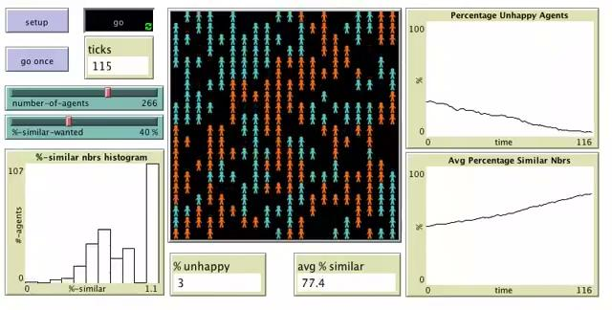
Different Threshold

Slide 20
Even Weaker Threshold

